Slide 1
Hack Your Future - ASP.NET Core -

Slide 2

Agenda
Anatomy of ASP.NET Core
Controllers
Routing
Models
Web API
MVC

Slide 3

Joren Vandekerckhove
IT Consultant at Axxes
1 year
UGent
25 jaar
Free time
Learning new technologies
Running
Fitness
Kickboxing

Slide 4

Who are you?

Slide 5
ASP.NET Core
Anatomy

Slide 6
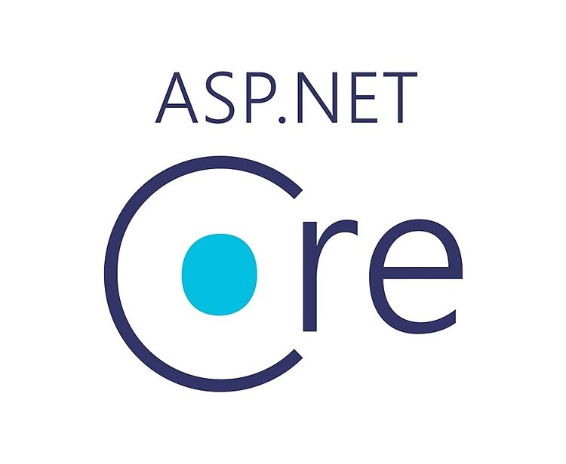
ASP.NET Core – What is it
Open-source and cross-platform framework
Cloud based applications
Web apps, IoT apps, mobile backends, ...
Runs on .NET
Why using it?
Supports Multiple Platforms: Windows, Mac and Linux
Fast
Integration with Modern UI Frameworks
Hosting on multiple platforms

Slide 7


ASP.NET Core vs ASP.NET

Slide 8
ASP.NET Core vs ASP.NET
ASP.NET Core
ASP.NET
Build for Windows, macOS or Linux
Razor Pages is the recommended approach to create a Web UI as of ASP.NET Core 2.x.
Multiple versions per machine
Higher performance than ASP.NET 4.x
Use .NET Core runtime
Build for Windows
Use Web Forms, SignalR, MVC, Web API, WebHooks, or Web Pages
One version per machine
Good performance
Use .NET Framework runtime

Slide 9
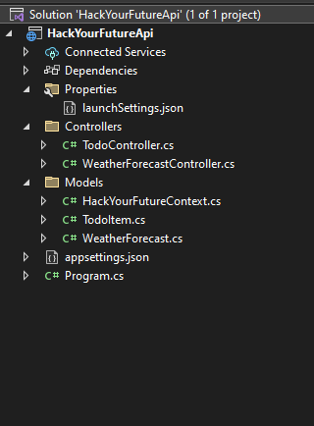
ASP.NET Core – Web API example
LaunchSettings.json = project launch settings
appsettings.json = settings like for logging, allowedhosts, ...
Program.cs = start of the whole project
Controllers = processes requests of users
Models = Data logic

Slide 10
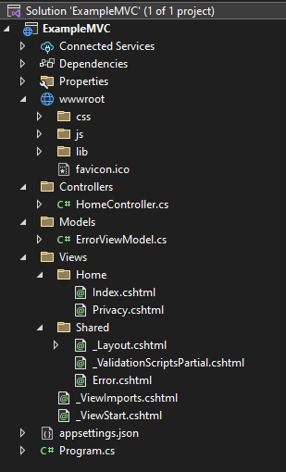
ASP.NET Core – MVC example
LaunchSettings.json = project launch settings
wwwroot = collection of static files
Views = collection of views
Controllers = collection of controllers
Models = collection of models
appsettings.json = settings like for logging, allowedhosts, ...
Program.cs = start of the whole project

Slide 11
ASP.NET Core
Controllers

Slide 12
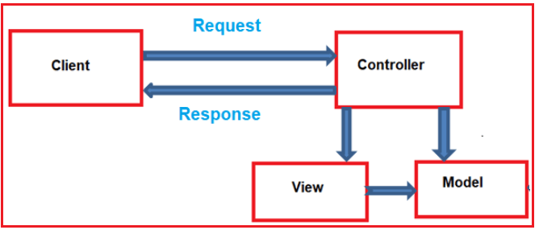
ASP.NET Core – Controllers
Process incoming requests
Perform operations on data
Select views to render
Stored in the Controllers folder

Slide 13
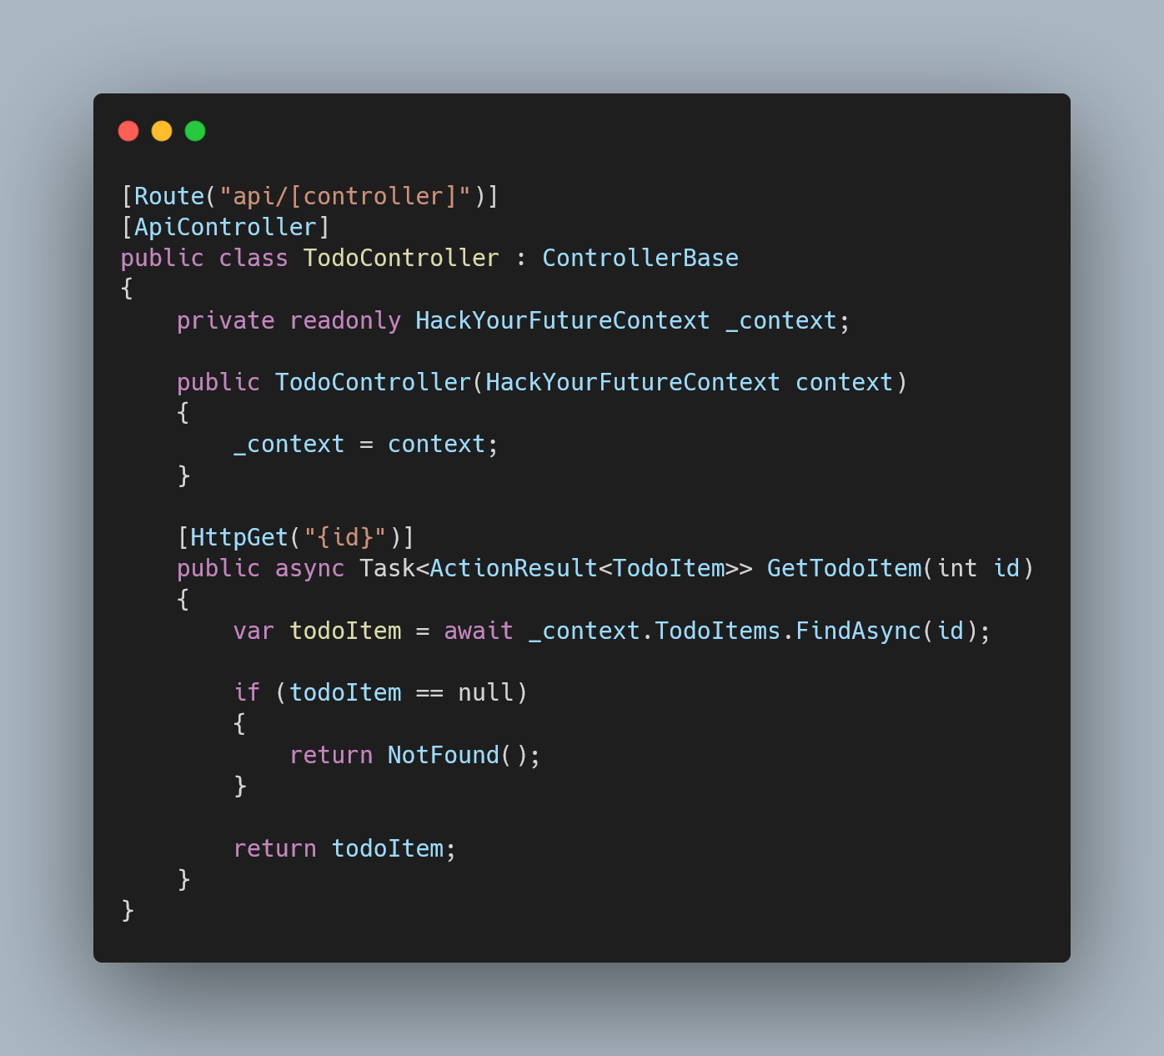
ASP.NET Core – Controllers

Slide 14
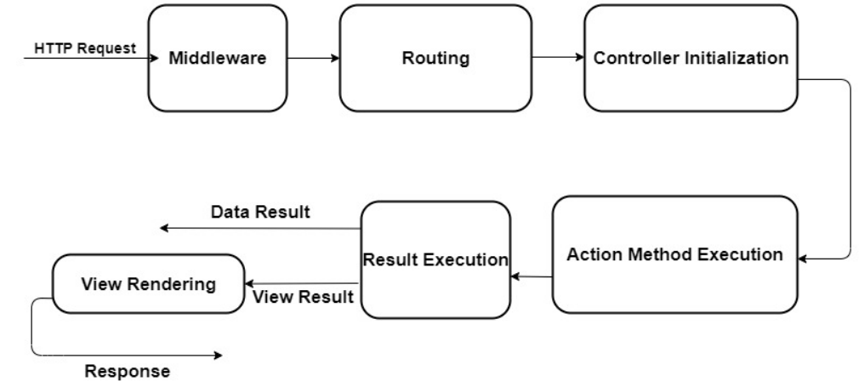
Controllers lifecycle

Slide 15
ASP.NET Core
Routing

Slide 16

ASP.NET Core – Routing

Slide 17
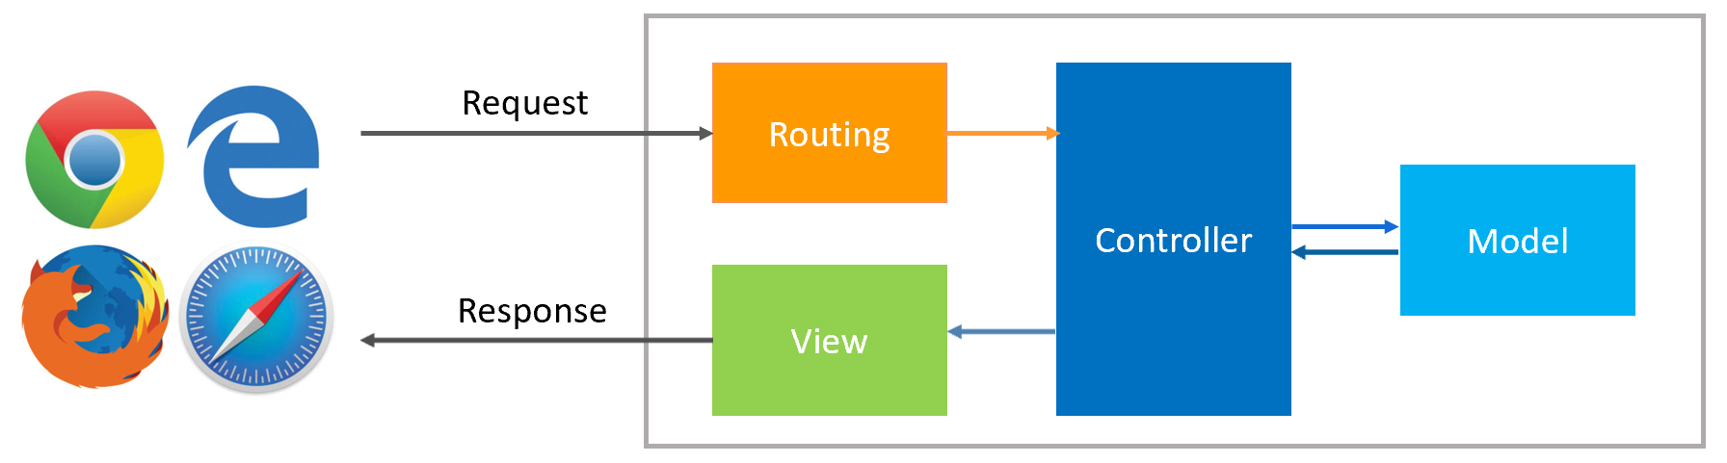
ASP.NET Core – Routing
Controllers use the Routing middleware
Route templates
Program.cs or in attributes
Conventionally-routed or attribute-routed.

Slide 18
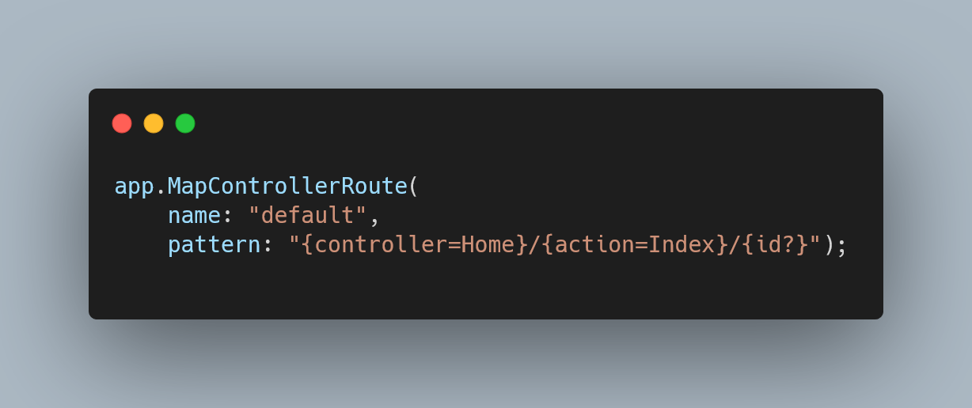
Conventional routing
Used with controllers and views
Sets a convention for URL paths
Example here
First segment = controller
Second segment = action
Third segment is optional (“?”)
Is based on controller and action names

Slide 19
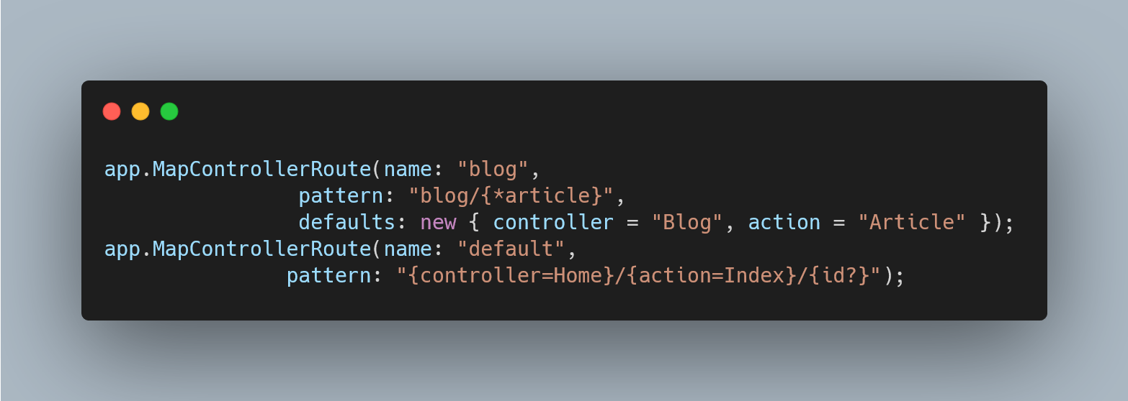
Multiple conventional routing
Allows defining multiple conventions
Dedicated to a specific action
Blog → dedicated conventional route:
Uses conventional routing
Dedicated to specific action
/Blog, /Blog/Article and /Blog/{any-string}
Higher priority

Slide 20
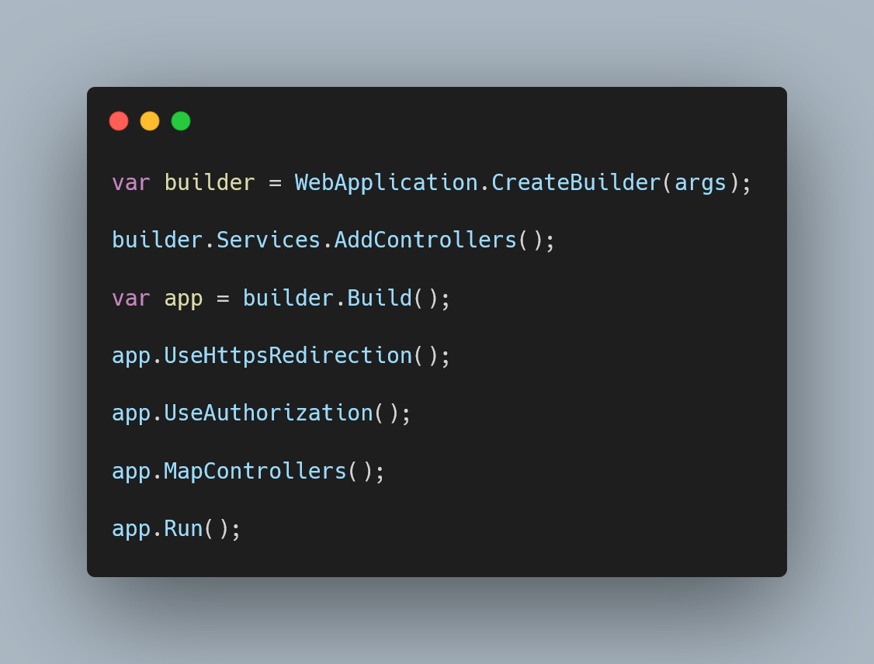
Attribute routing
Used for REST APIs
Map actions directly to route templates
MapControllers → map attribute routed controllers

Slide 21
ASP.NET Core
Models

Slide 22
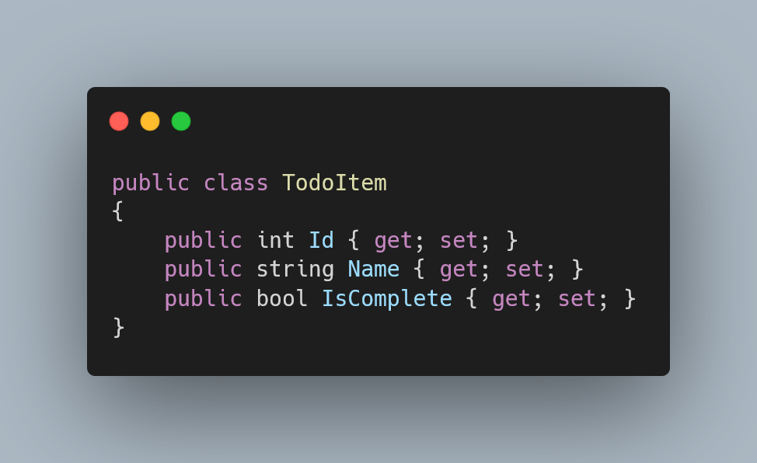
ASP.NET Core – Models
Is a class
Get or set data
Contains logic to manage business data
ASP.NET Core MVC

Slide 23
ASP.NET Core
Web API

Slide 24
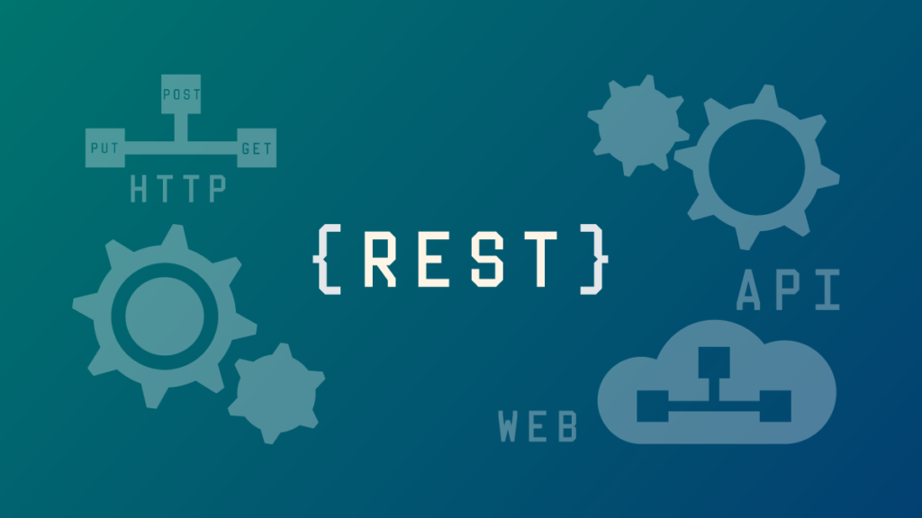
ASP.NET Core – Web API
Application Programming Interface for a web application
Uses HTTP protocol for communication
ASP.NET Core web API → cross-platform web API
Mobiles, browsers, ...

Slide 25
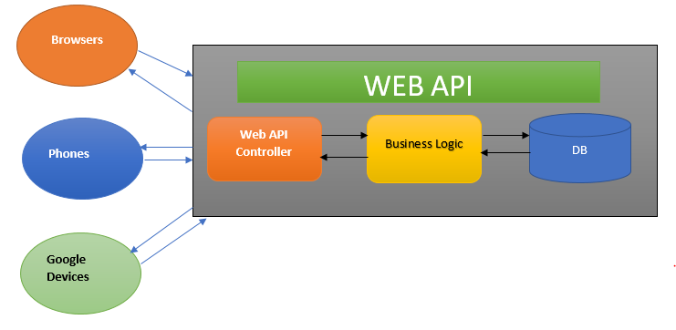
ASP.NET Core – Web API

Slide 26
ASP.NET Core
MVC

Slide 27
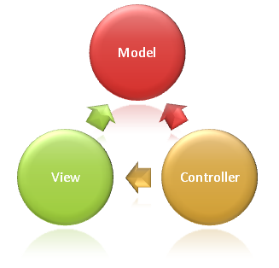
ASP.NET Core – MVC
Model-View-Controller
Separation of concerns
Helps you scale the application

Slide 28
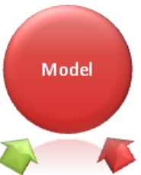
ASP.NET Core – MVC - Model

Slide 29

ASP.NET Core – MVC - View

Slide 30
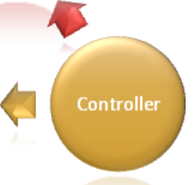
ASP.NET Core – MVC - Controller

Slide 31
Bilbiography
Introduction to ASP.NET Core
Routing to controller actions in ASP.NET Core
Routing in ASP.NET Core
ASP.NET Core MVC Request Life Cycle
ASP.NET Core in action
ASP.NET MVC Life Cycle
ASP.NET Core Github
Side-by-side execution ASP.NET

